Slide 1
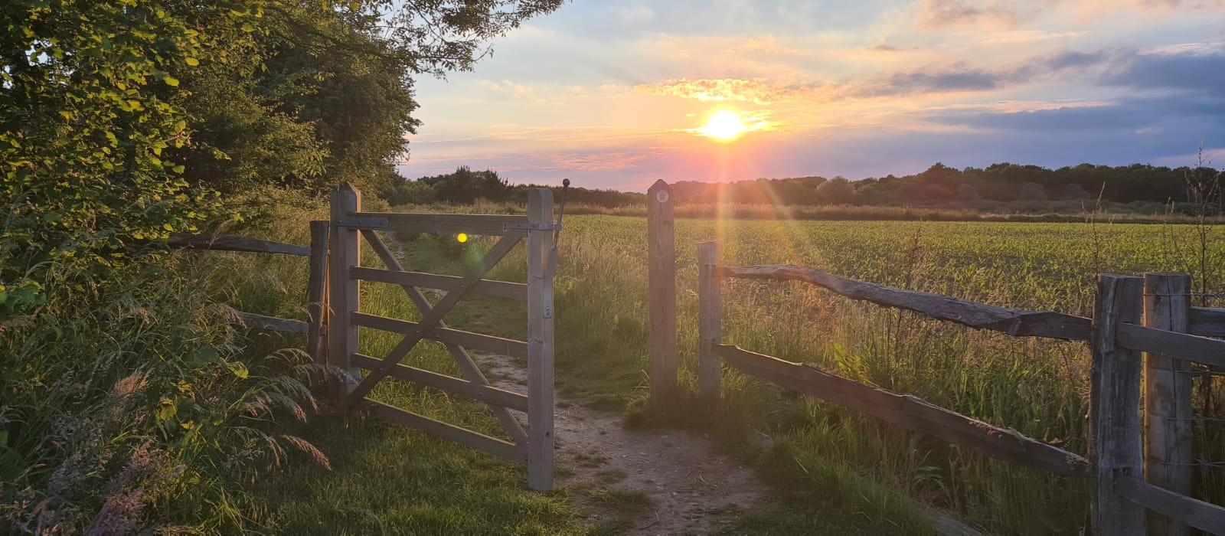

Hart Countryside: History and reflections on Basingbourne Heath
Adam Green – Environmental Promotions Manager

Slide 2
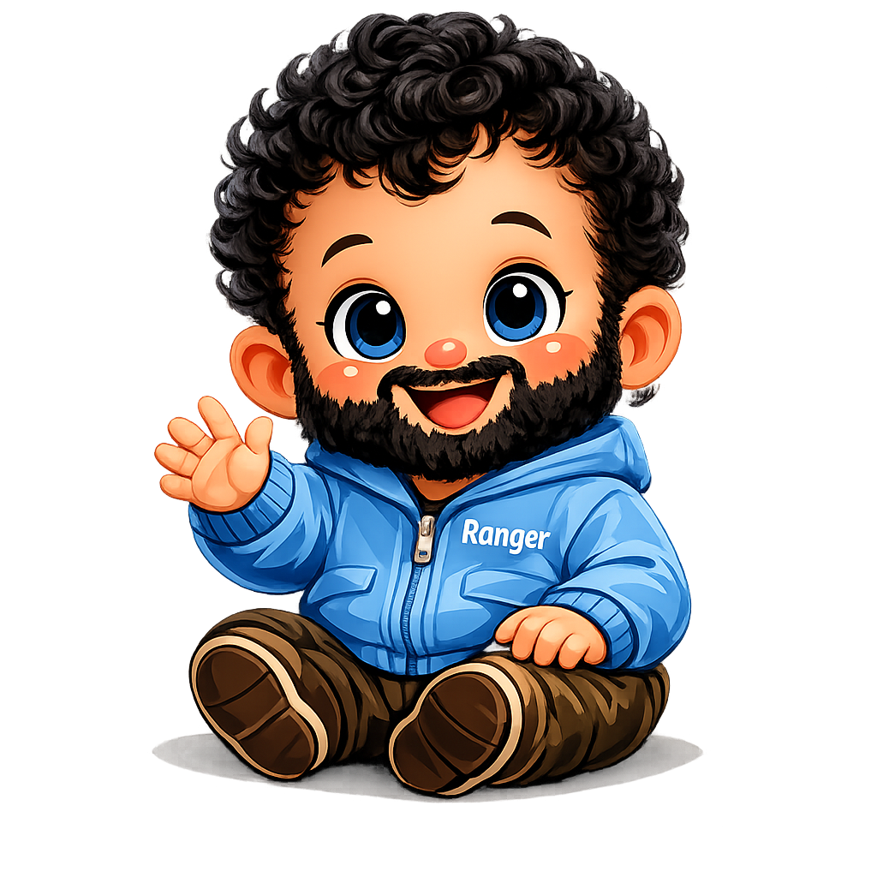

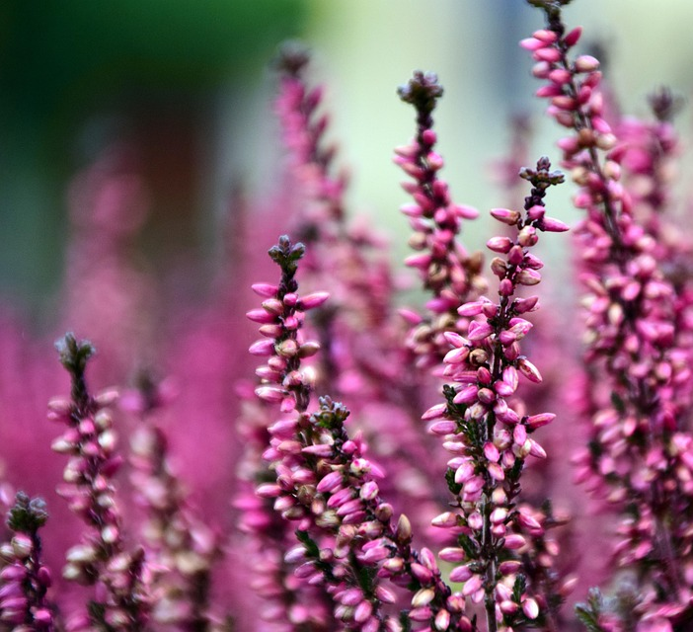
….In the beginning
1996 – Hart Countryside Service was born

Slide 3
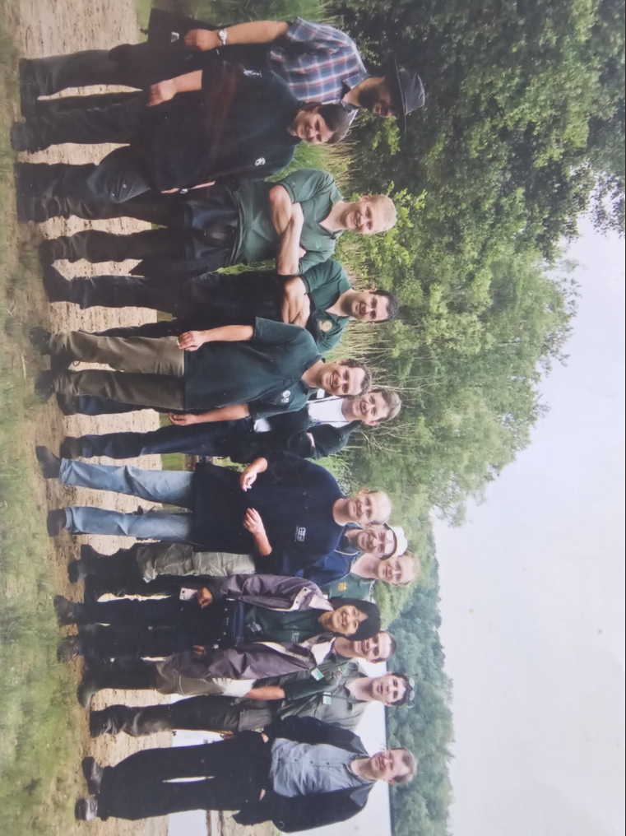
….In the beginning
The Next 10 Years…
Managed Fleet Pond and Odiham Common (Man Plans and Grazing)
1998 Service was threatened with closure
1999 Hart finds the funding and we are made permanent ☺
Expansion! – Hazeley Heath, Oakley Park, Basingbourne Heath
SKINT!!!!

Slide 4
….In the beginning

Slide 5
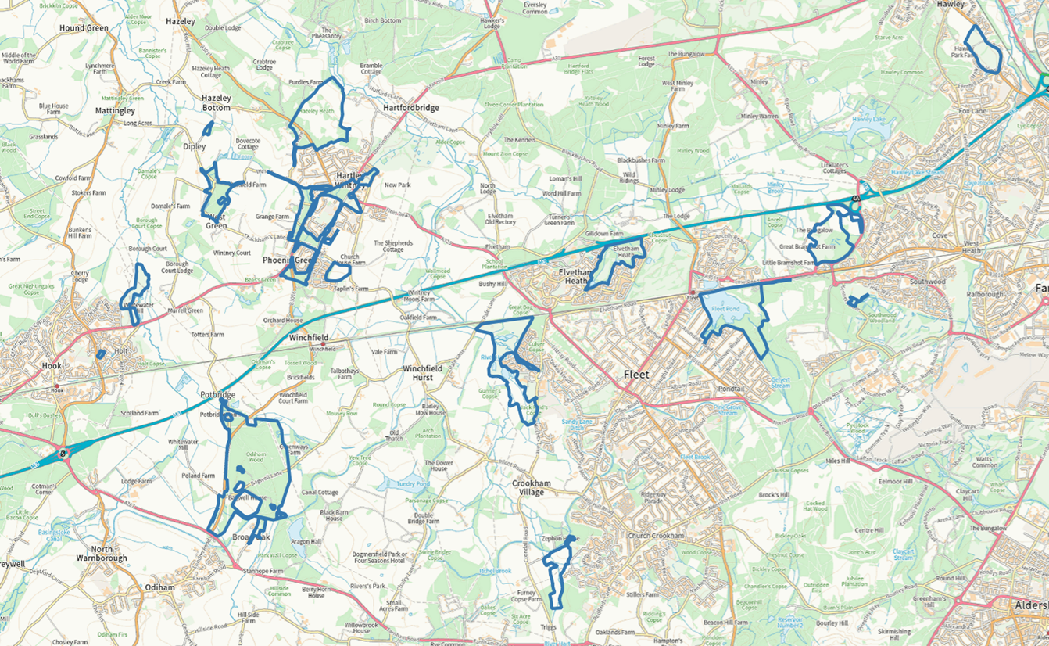
….10 years after..
The Next 20 Years…
Expansion and Development – Elvetham and Hook
2009 - Transfer of Hart local sites
2010 – Fleet Pond Restoration (Phase1)
2012 – First Green Flag Awards
2010’s – Expansion of Services (Grounds and Leisure)
2015 – First SANGs (Edenbrook)
2020 – Present day (Local Government Review)

Slide 6
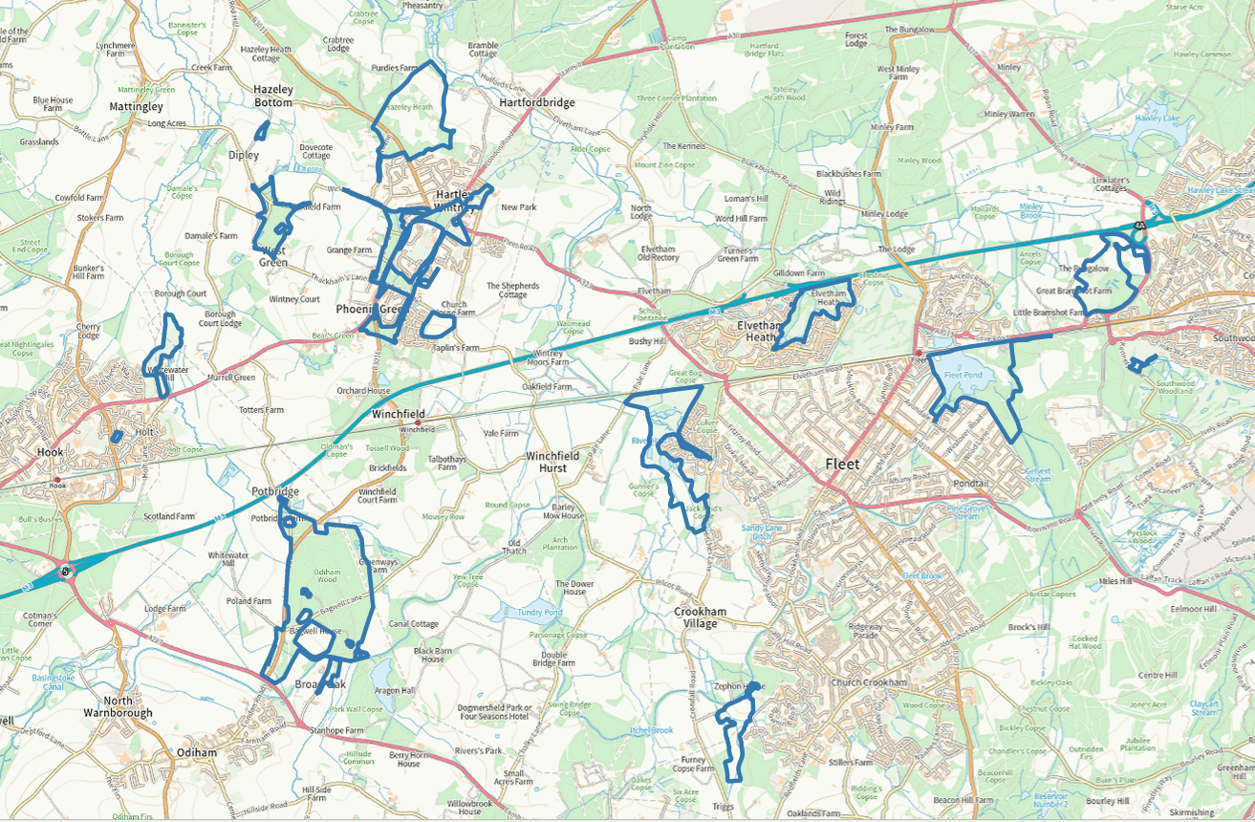
….NOW
£70 million
£2 Million
£20 million (H&W)
£7 Million
£30,000 Grants

Slide 7
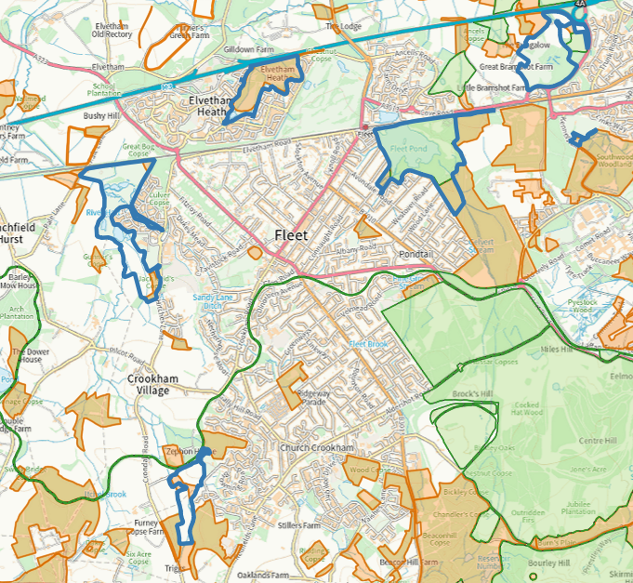
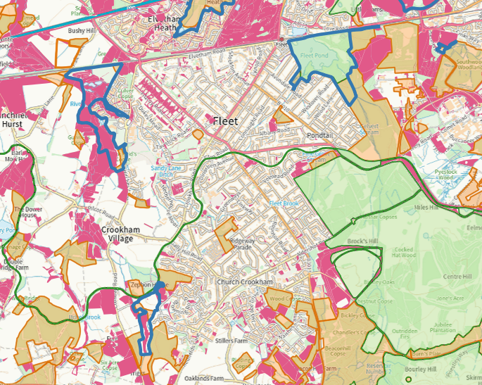
….In the beginning
(Again)…

Slide 8

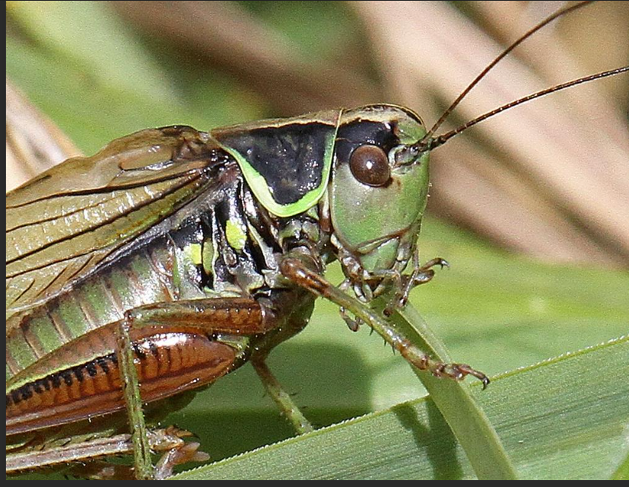
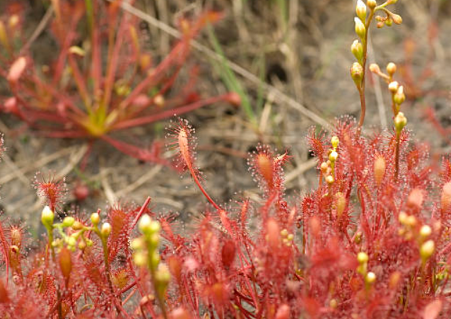
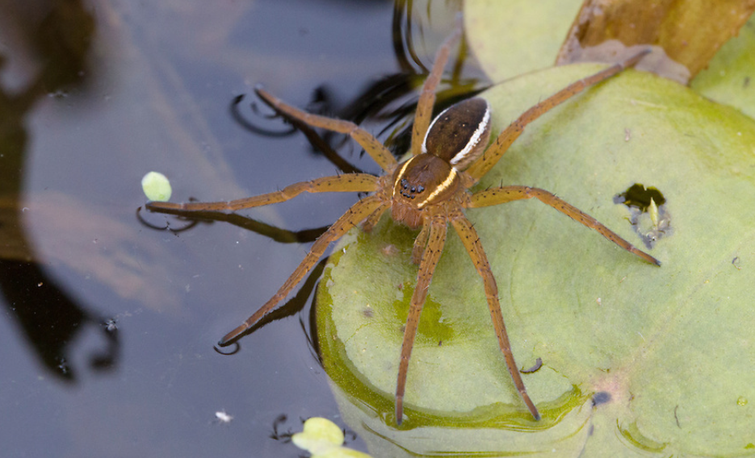
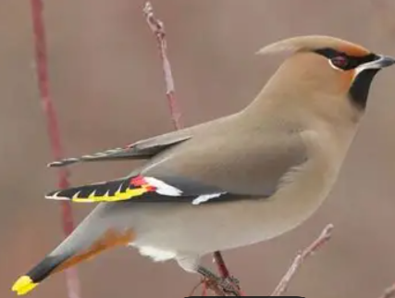
….In the beginning (Again)…

Slide 9
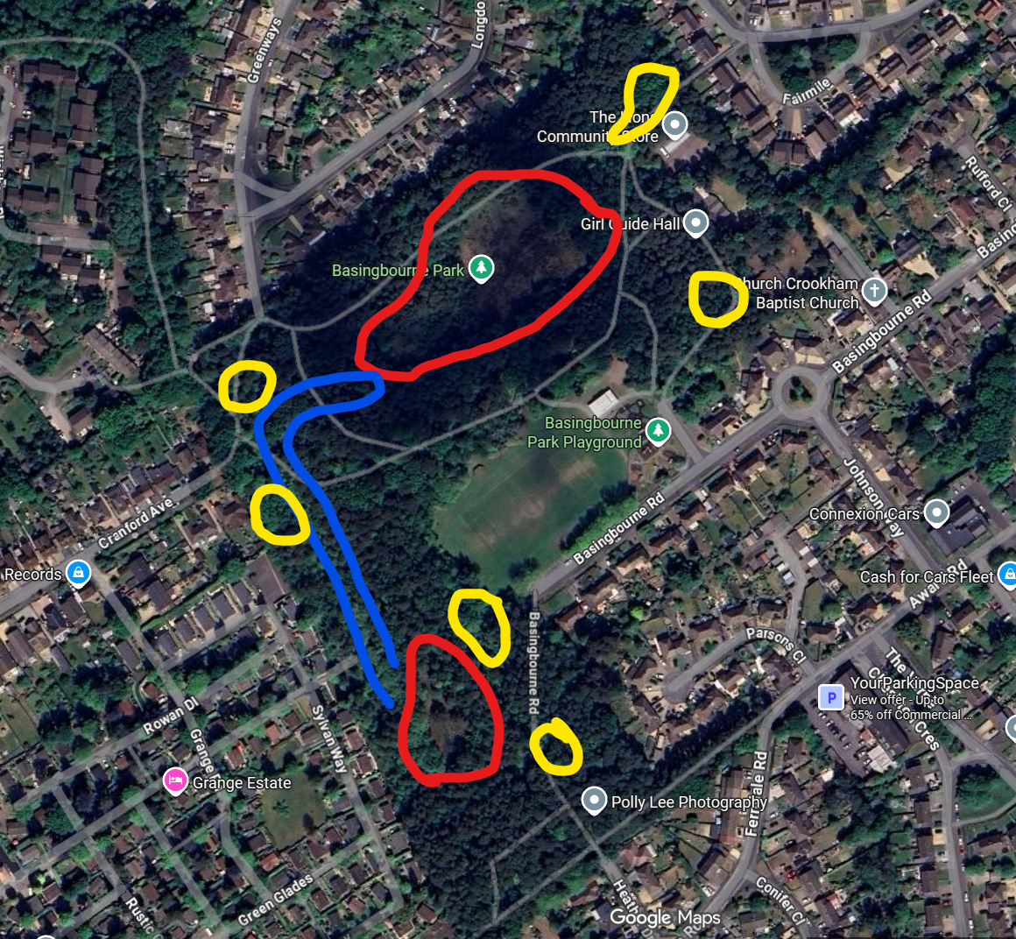


….In the beginning
(Again)…
Establish management
Cars, Kids, Fires
Expand the habitats
Link the habitats
SKINT!!!!

Slide 10
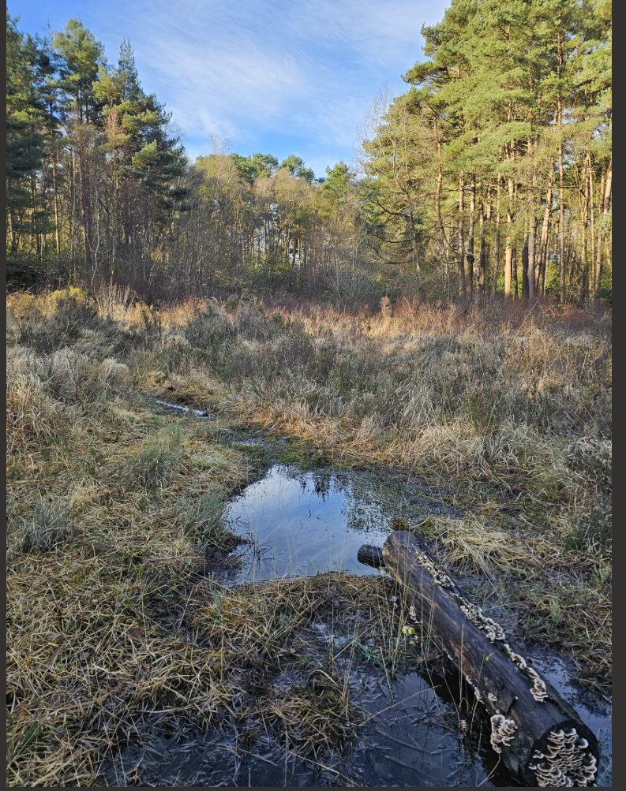
….Lots of possibilities
Where succession to woodland is checked, a mixed age structure of heather develops and plants representing all phases are distributed throughout the vegetation. When large areas are destroyed (for example, through fire), large, homogeneous areas of vegetation where all the plants belong to one phase (having the same age and structure), develop.
The structural changes taking place in the Heather community have profound effects on the development of other species, considerably altering such factors as microclimate and available bare ground for colonization. This can be translated into comparable stages in the development of heathland.
Pioneer;
Building;
Mature;
Degenerate.

Slide 11
….In the beginning
Under the Environment Act 2021, public authorities in England, including parish and town councils, must consider what they can do to conserve and enhance biodiversity. This is known as the ‘biodiversity duty’.
Following first consideration, parish councils must agree policies and objectives as soon as possible after 1 January 2024. They must also reconsider the actions they are taking, at least every 5 years.
“The duty should not be seen as a burden, it is an exciting opportunity to rethink how we work and how we manage land. By supporting the natural environment, towns and parishes are not just helping to conserve biodiversity but will also be improving the sustainability and quality of life in their communities”.

Slide 12
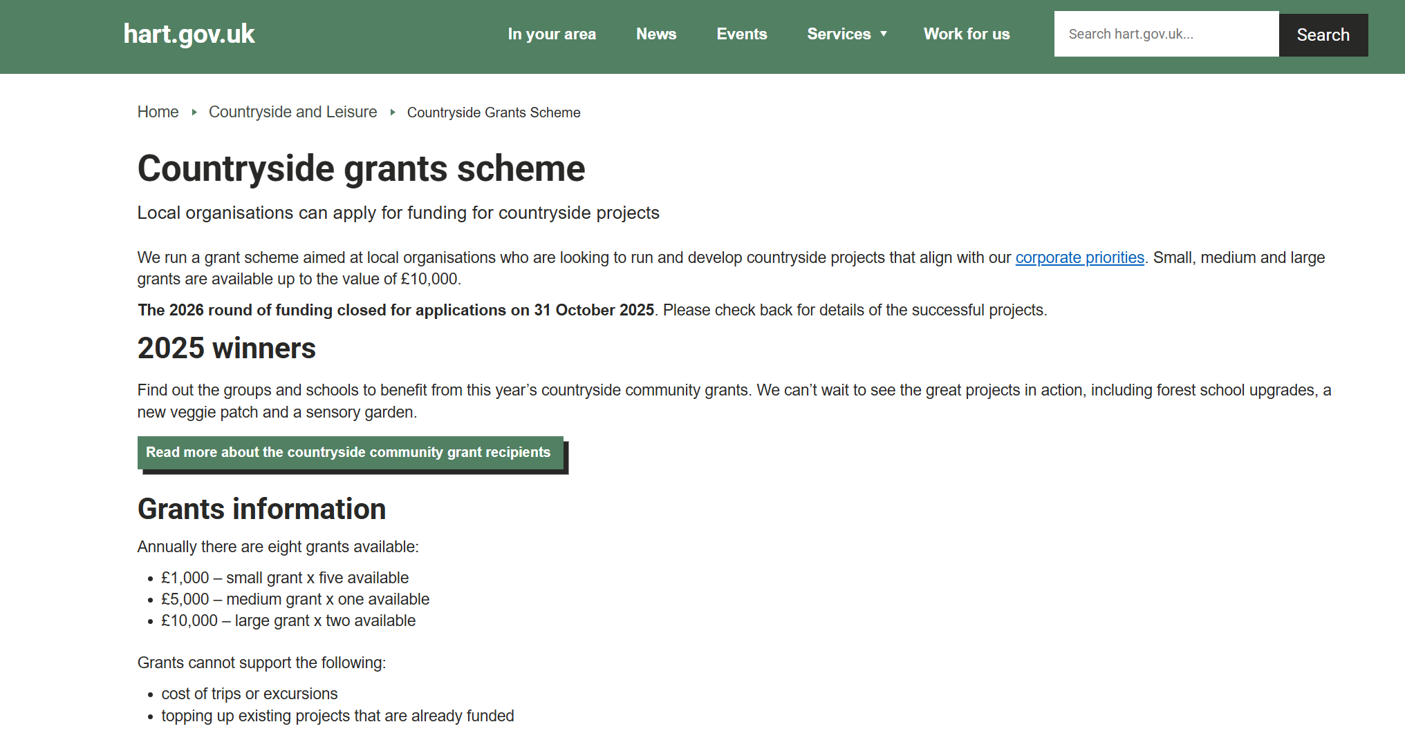
Countryside grants scheme
Local organisations can apply for funding for countryside projects
We run a grant scheme aimed at local organisations who are looking to run and develop countryside projects that align with our corporate priorities. Small, medium and large grants are available up to the value of £10,000.
The 2026 round of funding closed for applications on 31 October 2025. Please check back for details of the successful projects.
2025 winners
Find out the groups and schools to benefit from this year’s countryside community grants. We can’t wait to see the great projects in action, including forest school upgrades, a new veggie patch and a sensory garden.
Read more about the countryside community grant recipients
Grants information
Annually there are eight grants available:
£1,000 – small grant x five available
£5,000 – medium grant x one available
£10,000 – large grant x two available

